Slide 1
Effectively Educating the Public and Decision-Makers about the State of our Oceans: Five Guiding Principles
Community Meeting on a Future Vision for COSEE & NSF Ocean Science Education
November 3, 2010
Edward Maibach, M.P.H., Ph.D.
emaibach@gmu.edu
Notes:
Cover slide

Slide 2
#1: The less you say, the more you’re heard.
Identify the few most important things you want to say.
Say them early and often.
Encourage everyone in your community to say them early and often.
Make it easy for people in your priority audiences to say them to each other.
The formula for public education effectiveness:
“Simple clear messages, repeated often, by a variety of trusted sources.”

Slide 3
#2: The decision about what to say requires audience research.
What to say is determined by the needs of your audience, not by what you are most eager to say.
Use audience research to identify:
Which facts about the state of our oceans (5 max), once understood, make the biggest difference in helping audience members grasp the current state of the science?
Which misperceptions (3 max) are the biggest impediment to audience members’ understanding of the current state of the science?

Slide 4
#3: There is no such thing as “the public.”

Slide 5
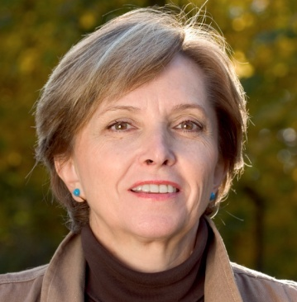
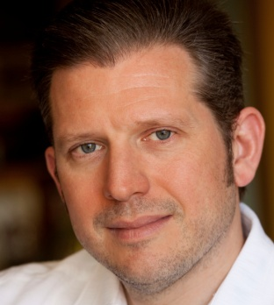
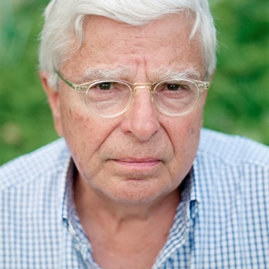
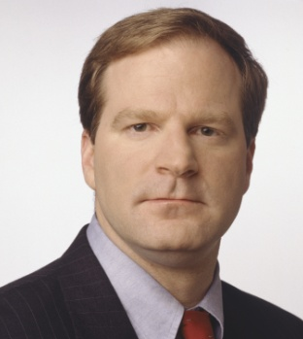
#3: There is no such thing as “the public.”
Example: Global Warming’s Six Americas
Source: Yale & George Mason, June 2010

Slide 6
“If you could ask an expert on global warming one question,
which question would you ask?”
What can the US do to reduce global warming?
How do you know that global warming is occurring?
What harm will global warming cause?
Source: Yale & George Mason, June 2010

Slide 7
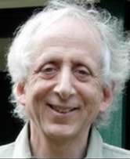
#4. If failure (of the public education effort) is not an option, create a public education team.
Effective public education is a team sport involving collaboration between:
Content experts
Decision science experts
Communication experts
Baruch Fischhoff (2007). Non-persuasive Communication about Matters of Greatest Urgency: Climate Change. Environmental Science & Technology Online. 41:7204-8.

Slide 8
#5: Clearly identify which personal actions, and which societal actions, are most important.
Proactively answer these questions:
What can I do to help?
What can this (company/community/state/nation) do to help?
Because of our “single action bias,” less is more.
Focus on the most important actions that will be acceptable to the largest number of people.
The most effective solutions, if unacceptable to large numbers of people, are not helpful.
Minimally effective solutions, even if embraced by large numbers of people, are not very helpful.
Notes:
What Is the Single Action Bias? In response to uncertain and risky situations, humans have a tendency to focus and simplify their decision making. Individuals responding to a threat are likely to rely on one action, even when it provides only incremental protection or risk reduction and may not be the most effective option. People often take no further action, presumably because the first one succeeded in reducing their feeling of worry or vulnerability. This phenomenon is called the single action bias. (From http://www.cred.columbia.edu/guide/guide/sec4.html)

Slide 9
In Summary:
To get your public education content right:
Create a multi-discipline education team
Study your audience carefully
To ensure that your content is received & learned:
Simple clear messages, repeated often, by a variety of trusted source.
To maximize the odds that your public education will influence people’s actions appropriately:
Clearly identify which personal actions, and which societal actions, are most important.

Slide 10
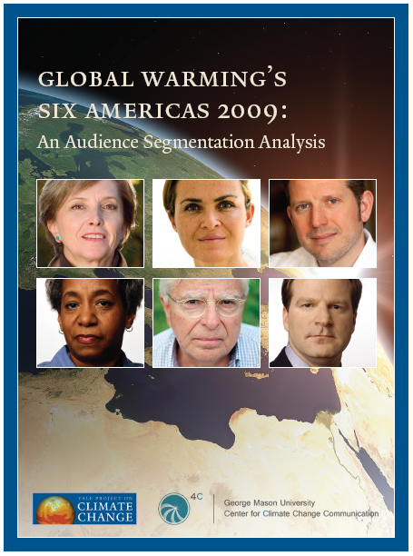
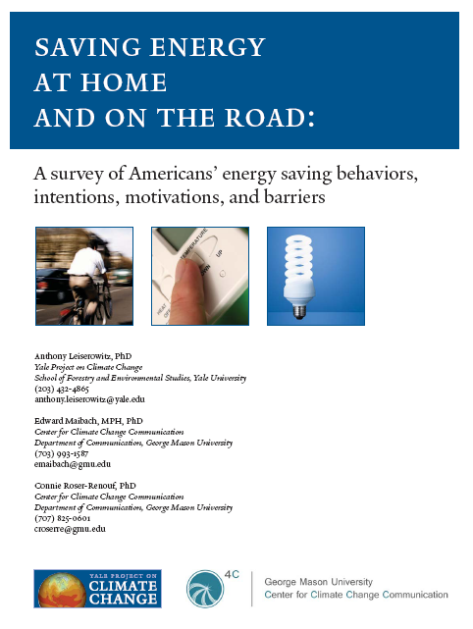
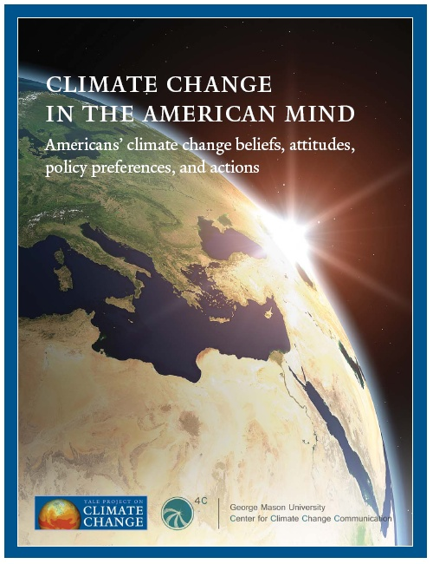
All 4C reports can be downloaded at:
Climatechangecommunication.org
Notes:
Q-R code is to the 4C website

