Slide 1
Research-based Information on Diverse 21st Century Students & Resources to Help Them Thrive in SBS
Guests:
Chris Cash, IBP Director of Student Assistance Programs
Dr. J. Theodore Repa, Touro College & New York University Graduate School of Education (retired)
David Siegfried, IBP Director of Assessment Processes

Slide 3
Recent trends in undergraduate enrollment reflect the growth and changing composition of the U.S. college-age population. Most notably, underrepresented minorities are an increasing fraction of undergraduate students, and whites are a decreasing fraction. Among all racial/ethnic groups, more women than men enroll in college.

Slide 4
Underrepresented minorities' —blacks, Hispanics, and American Indians— shares of science and engineering bachelor's and master's degrees have been rising over the two decades since 1991, with shares of doctorates in these fields flattening well below 10% after 2000.

Slide 5
Since 1991, the greatest rise in the share of science and engineering bachelor's degrees earned by underrepresented minorities has been in psychology, the social sciences, and computer sciences. Since 2000, underrepresented minorities' shares in engineering and the physical sciences have been flat, and participation in mathematics has dropped.

Slide 6
Biological sciences
Physical sciences
Underrepresented minority women, like women in general, earn higher proportions of bachelor's degrees in psychology and the social sciences than in engineering, computer sciences, and mathematics.

Slide 7
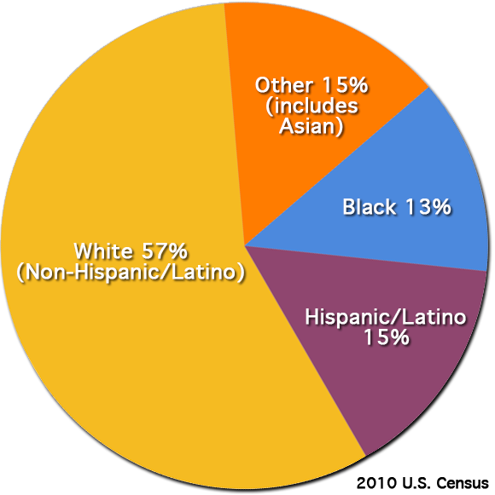
The science and engineering workforce is largely white and male. Minority women comprise about 1 in 10 employed scientists and engineers.

Slide 8
W
W
W
W
W
W
W
W
The share of full-time, full professorships held by underrepresented minorities is lower and has risen more slowly than the share held by women, shown here as "W" (<10% in 1993 and just over 20% in 2010).

Slide 9
Shifting Job Market
20th Century
21st Century
1 – 2 Jobs
10 – 15 Jobs
Number of
Jobs:
Mastery of
One Field
Critical Thinking Across Disciplines
Job
Requirement:
Subject
Matter
Mastery
Integration of 21st
Century Skills into
Subject Matter
Mastery
Teaching
Model:
Linda Froschauer, National Science Teachers Association (via Jay Labov, National Research Council)
Notes:
21st Century Jobs Require 21st Century Skills

Slide 10
21st Century Skills
We can help you to include these skills in your courses!

Slide 11
Larger SBS Cohort Might Benefit from Group-based "Active Learning"

Slide 12
With this Info in Mind, What's Next?
Instructing Students with Diverse Backgrounds (Ted) – 20 min.
Clear expectations (written and oral)
Strategic & effective group work to break down barriers & enhance learning
Mentoring Students from Diverse Backgrounds (Sieg) – 20 min.
Influencing diverse students' learning both inside & outside of the classroom (over the semester)
Online Resources for Students & Faculty (Chris) – 15 min.
Walkthrough of IBP web-based resources
Demonstration of searching for specific resources & opportunities
Facilitated Activity (All) – 15 min.
Choose one topic, Do a search, Ask a question or make a comment:
Partnership Directory
Mentorship Manuals
Student Searches for Resources

Slide 13
Resources
NSF's "Women, Minorities, and Persons with Disabilities in Science and Engineering"
www.nsf.gov/statistics/wmpd/2013/
President's Council of Advisors on Science and Technology (PCAST): Engage to Excel
www.whitehouse.gov/sites/default/files/microsites/ostp/pcast-engage-to-excel-final_2-25-12.pdf
Institute for Broadening Participation
www.ibparticipation.org
21st Century Skills: Preparing Students for Their Future
https://www.mheonline.com/mhmymath/pdf/21st_century_skills.pdf
Many Learning Pathways in the Ocean Sciences – Webinar Series
cosee.umaine.edu/programs/webinars/mlpios/

